Slide 1
Tampines Regional Library
LearnX Community
Raspberry Pi Python Workshop
Course Material
By
Goh Soon Seng
PLEASE DO NOT WRITE ANYTHING ON THE PAGES OF THIS BOOKLET. THANK YOU.

Slide 2
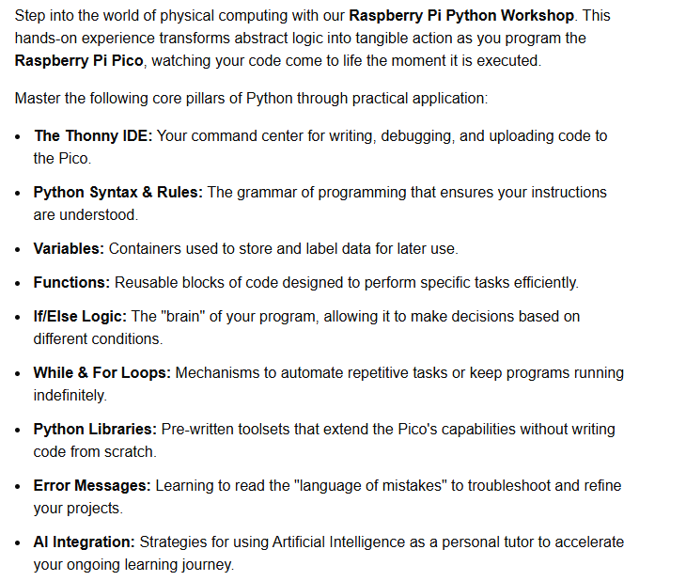
Raspberry Pi Python Workshop

Slide 3
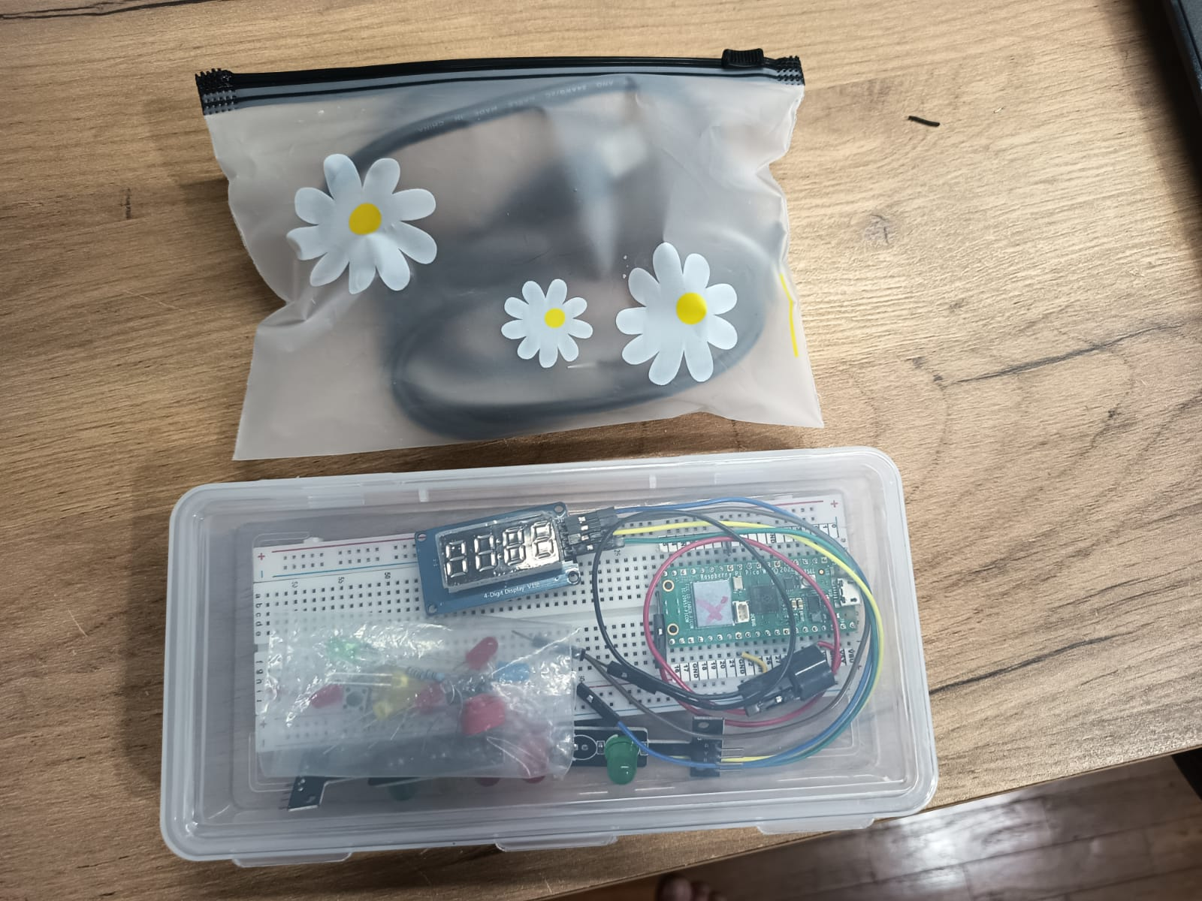
Please Return them like this - tomorrow
Bag of wires
Raspberry Pico
Training kit

Slide 4
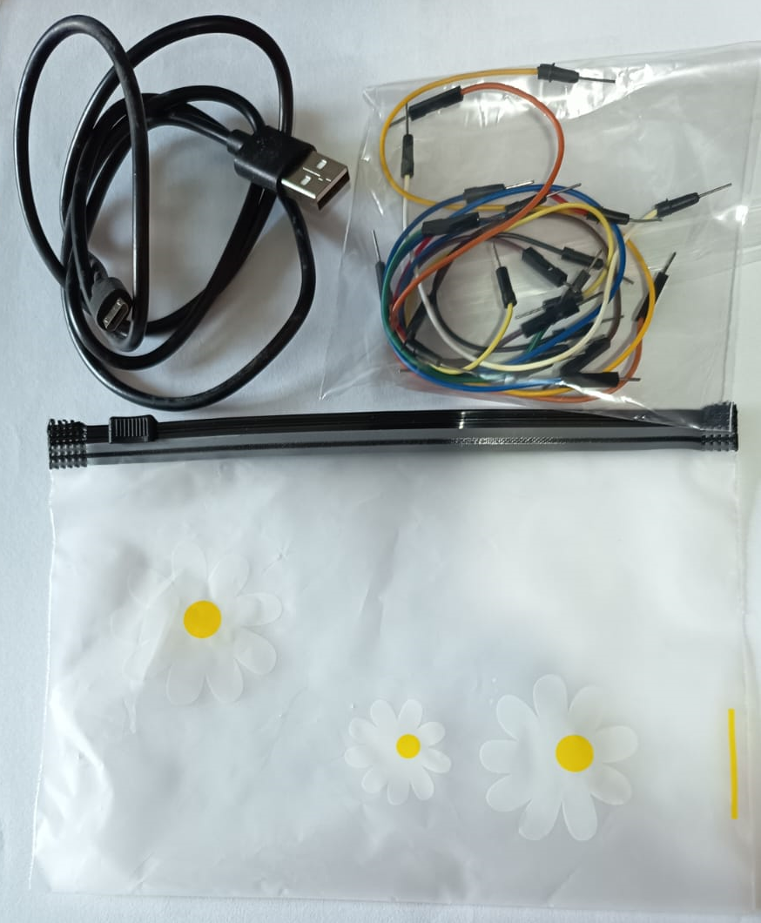
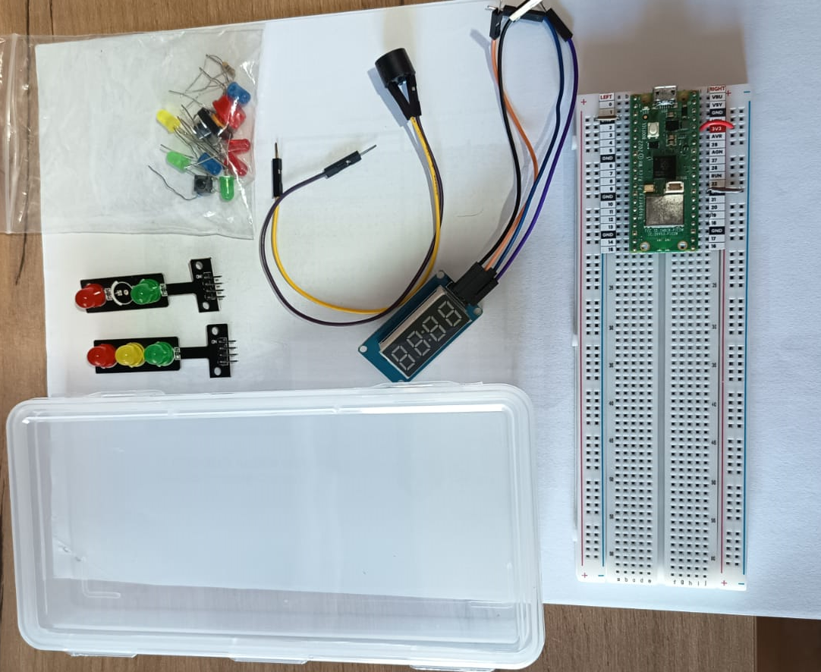
THE RASPBERRY PI PICO TRAINING KIT
JUMPER WIRES
BAG
BOX
USB CABLE
PLEASE PACK THE KIT AT THE END OF THIS WORKSHOP
INTO IT’S ORIGINAL PACKAGING. THANK YOU

Slide 5
Python Lesson – Session # 1
LIBRARIES
machine
time
picozero
VARIABLES/NAMES
LOOPS
while True:
PYTHON RULE
Indentation / Code Blocks
Character casing
SAVING YOUR WORK
All Python files has .py extension
ALGORITHM
Formulating what you want the program to do / Recipe

Slide 6
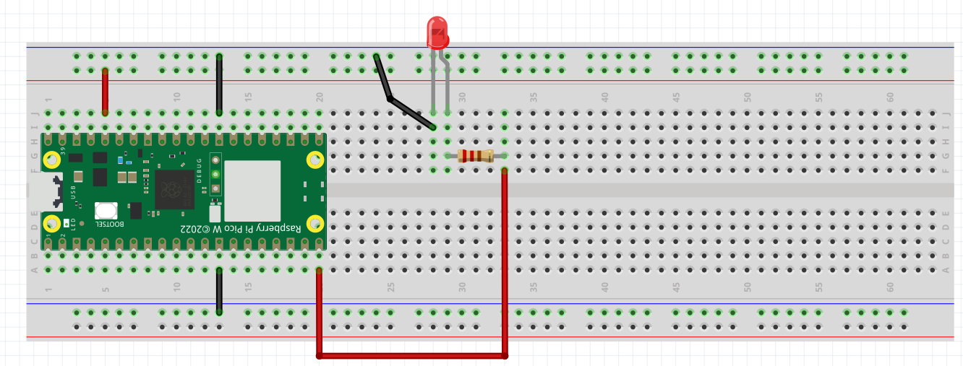
EXERCISE #1
Wiring a Light Emitting Diode (LED)
Please wire up the following circuit
red_led
GROUND
_
3.3V
+
GROUND
200 OHM RESISTOR
GROUND
3.3V
PIN 15

Slide 7
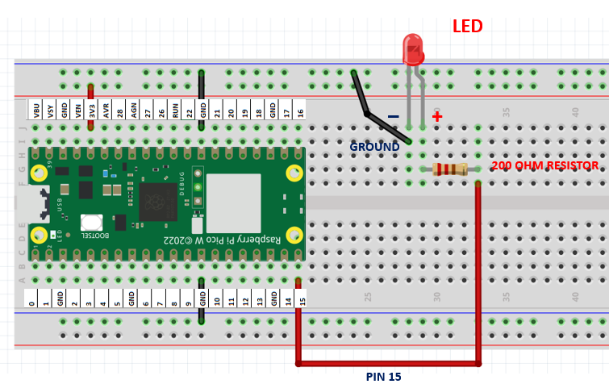

TESTING OUR CIRCUIT USING THONNY SHELL
Library
red_led
Ex 1a. Turning our Red LED on
>>> from picozero import LED
>>> red_led = LED(15)
Variable
>>> red_led.on()
Ex 1b. Turning it off
>>> red_led.off()
Start with red led off
Wait 1 second
Turn red led on
Wait 1 second
Turn red led off
Wait 1 second
Turn red led on
Wait 1 second
Turn red led off
Ex 1c. Blinking the red LED
Can you make it Blink too?

Slide 8
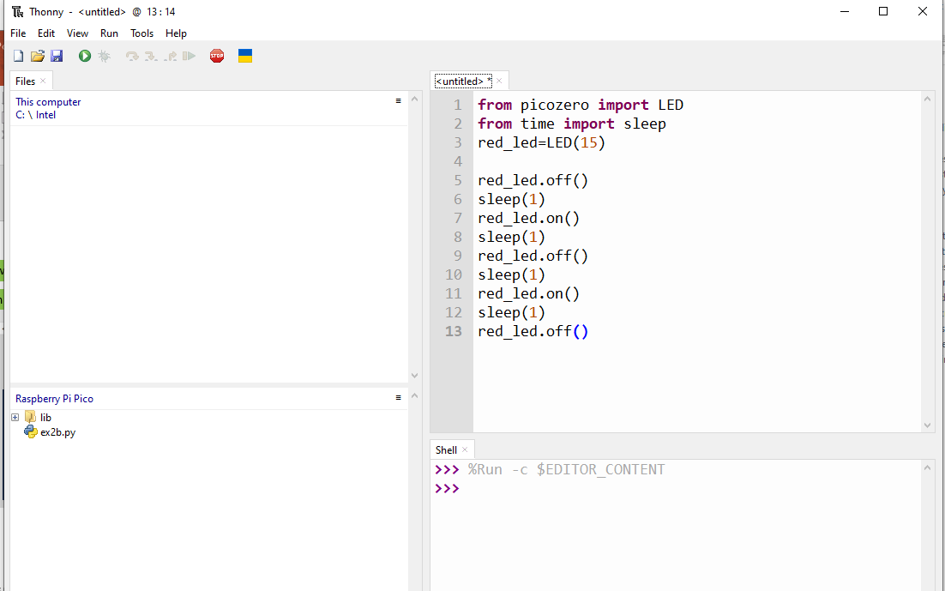
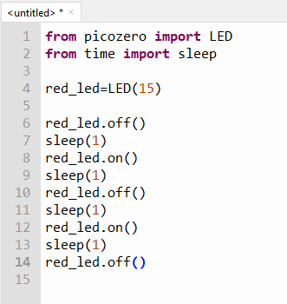
ALGORITHM TO CODE
Click here to start a new python program
Start with red led off
Wait 1 second
Turn red led on
Wait 1 second
Turn red led off
Wait 1 second
Turn red led on
Wait 1 second
Turn red led off
To run this python program
Editor
CODE

Slide 9
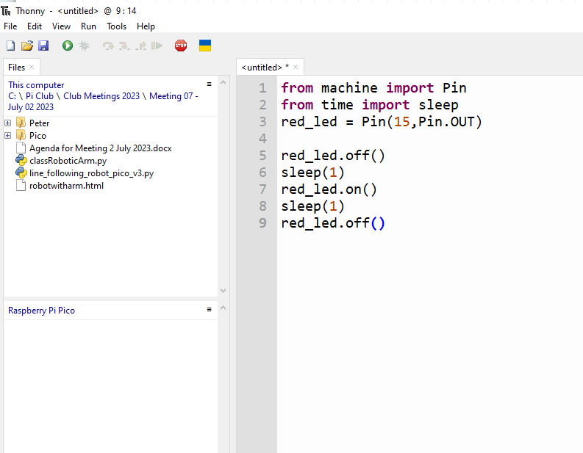
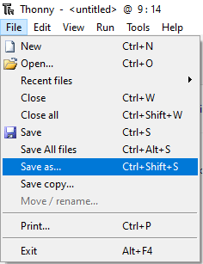
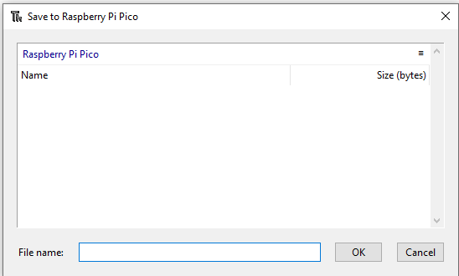
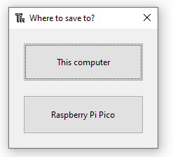
SAVING A PROGRAM
ex1c.py
ex1c.py

Slide 10
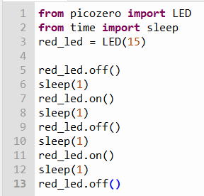
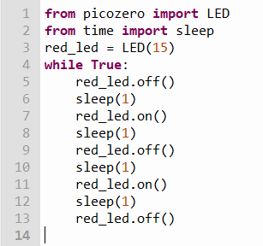
Python Syntax Rules
ex1c.py
Convert
indentation
Runs once
Runs forever
Save it as ex1d.py
Run this program

Slide 11
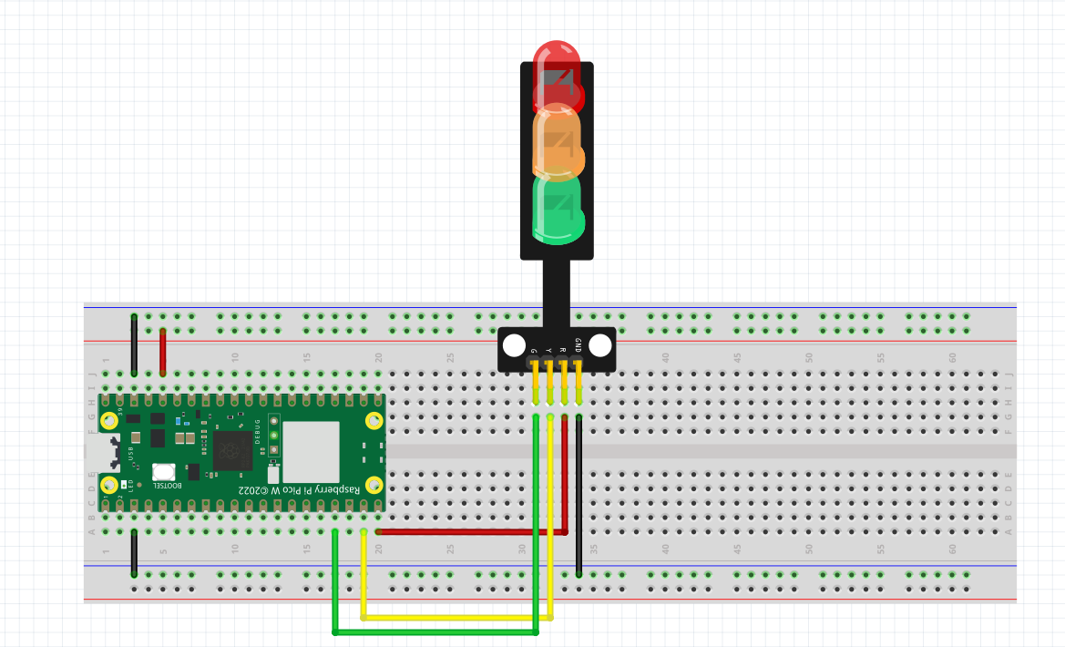
EXERCISE 2 – TRAFFIC LIGHT
Please wire up this new circuit
red_led
yellow_led
green_led
GROUND
3.3V
PIN 15
GROUND
PIN 14
PIN 13

Slide 12
EXERCISE 2 – CONTROLLING MULTIPLE LEDs
Ex 2a. Test the Circuit. Turn each of the LEDs ON and OFF
>>> from picozero import LED
>>> red_led= LED(15)
>>> yellow_led = LED(14)
>>> green_led=LED(13)
hint
Ex 2b. Turning the circuit into a Traffic Light System
Algorithm
Code
How does a traffic light work?
Green Light On
Give cars 10 seconds to cross
Green Light Off
Yellow Light On
Give 5 seconds warning
Yellow Light Off
Red Light On
Wait 10 seconds
Red Light Off
green_led.on()
sleep(10)
green_led.off()
yellow_led.on()
sleep(5)
yellow_led.off()
red_led.on()
sleep(10)
red_led.off()
How?
Code this in the editor
Run and save it as ex2b.py

Slide 13
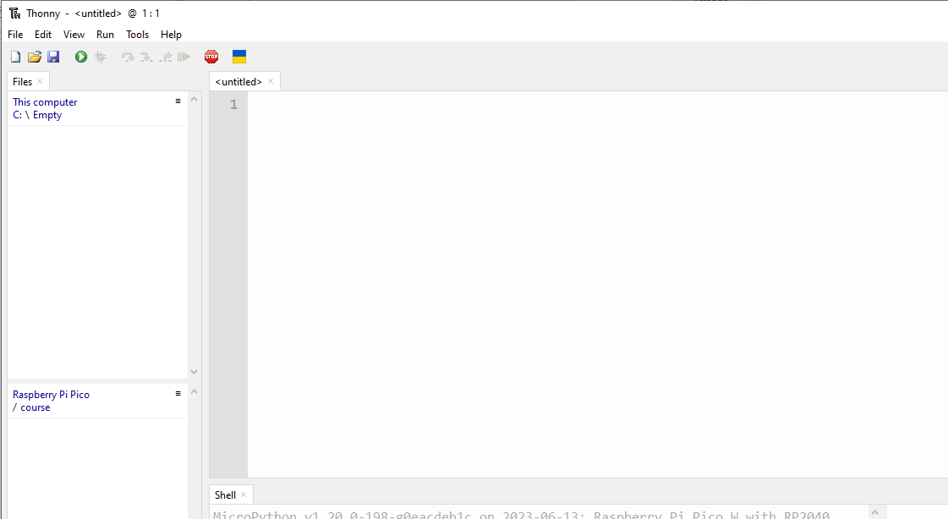
Lets create this program together
from picozero import LED
from time import sleep
red_led = LED(15)
yellow_led=LED( 14 )
green_led=LED( 13 )
green_led.on()
Run this program
Green Light On
Give cars 10 seconds to cross
Green Light Off
Yellow Light On
Give 5 seconds warning
Yellow Light Off
Red Light On
Wait 10 seconds
Red Light Off
sleep(10)
Save program as ex2c.py
green_led.off()
yellow_led.on()
sleep(5)
yellow_led.off()
red_led.on()
sleep(10)
red_led.off()

Slide 14
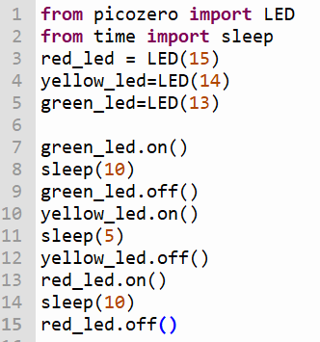
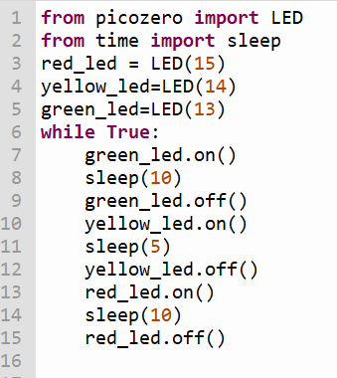
ex2c.py
convert
Runs forever
Runs once
Run the Program
Save it as ex2d.py

Slide 15
Python Lesson – Session # 2
FUNCTIONS
LOOPS
for loop
MESSAGING
how humans and machine communicate with each other

Slide 16
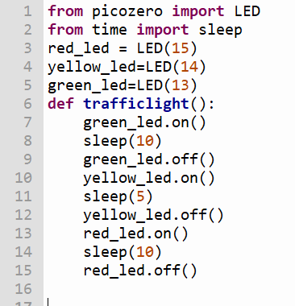

FUNCTION – A SET OF CODES WITH A NAME
ex2d.py
Run the Program
Save it as ex2e.py

Slide 17
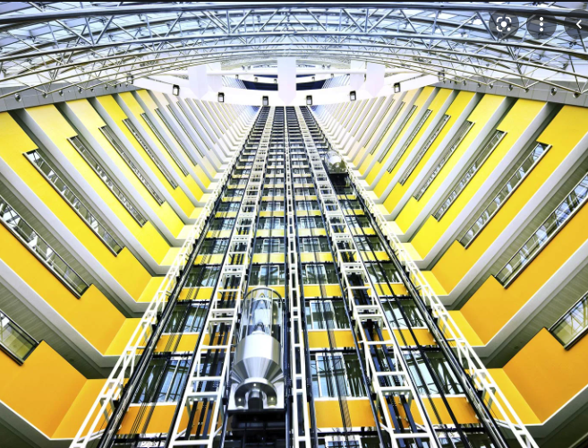


BUTTONS ARE EVERYWHERE IN THE REAL WORLD
HUMANS CANNOT DIRECTLY INTERACT WITH ELEVATOR SYSTEM
INTERACTION BETWEEN HUMANS AND THE REAL WORLD VIA A COMPUTER SYSTEM
ELEVATOR CONTROL SYSTEM
US HUMANS

Slide 18
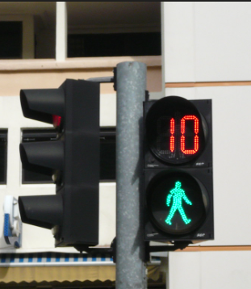
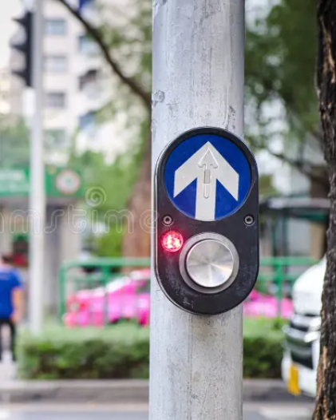
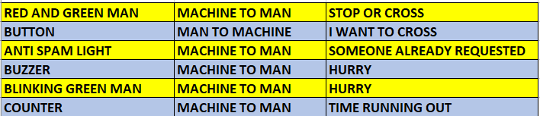
HOW DO HUMANS AND MACHINES COMMUNICATE IN THE REAL WORLD
WHAT DO YOU SEE AT A PEDESTRIAN CROSSING?
RED AND GREEN MAN
BUTTON
ANTI SPAM LIGHT
BUZZER
BLINKING GREEN MAN
COUNTER

Slide 19
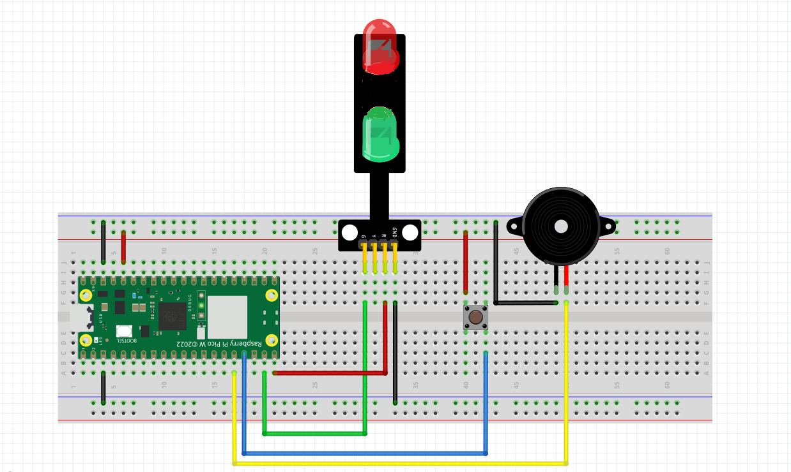
Exercise 3 – Wiring a Pedestrian Crossing
Look for + sign on the Buzzer
BUZZER
+
+
PIN 15
PIN 14
PIN 13
PIN 12
PIN 12

Slide 20
TESTING OUR CIRCUIT USING THONNY SHELL
Ex 3a. Turning our Buzzer on
>>> from picozero import Buzzer
>>> buzzer= Buzzer(12)
>>> buzzer.on()
Ex 3b. Turning it off
>>> buzzer.off()
Ex 3b. Setting up multiple sensors : our circuit has Buzzer, Button, LED
>>> from picozero import Buzzer, Button, LED
>>> buzzer= Buzzer(12)
>>> button=Button(13)
>>> red_led=LED(15)
Let’s say we want the LED
To light up when we press the button
And off when we release the button
>>> button.when_pressed = red_led.on
>>> button.when_released = red_led.off
Let’s say we want the BUZZER
To buzz when we press the button
And off when we release the button
>>> button.when_pressed = buzzer.on
>>> button.when_released = buzzer.off

Slide 21
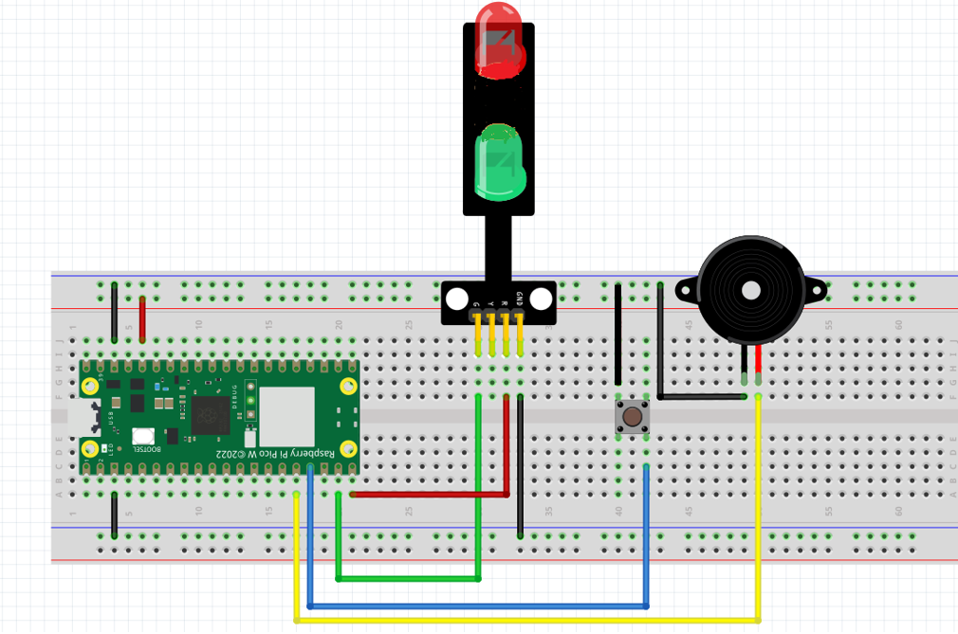
Exercise 3 – Pedestrian crossing : Algorithm to code
from picozero import LED, Buzzer, Button
from time import sleep
red_led = LED(15)
green_led=LED(14)
buzzer=Buzzer(12)
button=Button(13)
red_led.on()
green_led.off()
HOW DOES A PEDESTRAIN CROSSING WORK?
sleep(10)
red_led.off()
RED LED IS ON / GREEN LED IS OFF
WAIT FOR 10 SECONDS
RED LED GOES OFF
GREEN LED GOES ON
GIVE 10 SECONDS FOR PEOPLE TO CROSS
GREEN LED GOES OFF
RED LED TURNS ON
green_led.on()
convert
sleep(10)
green_led.off()
TO CODE
red_led.on()
RUN and
Save this program as ex3c.py

Slide 22
Exercise 3 – Turning the circuit into a pedestrian crossing with code
from picozero import LED, Buzzer, Button
from time import sleep
red_led = LED(15)
green_led=LED(14)
buzzer=Buzzer(12)
button=Button(13)
while True:
red_led.on()
green_led.off()
sleep(10)
red_led.off()
green_led.on()
sleep(10)
green_led.off()
red_led.on()
red_led.on()
green_led.off()
sleep(10)
red_led.off()
green_led.on()
sleep(10)
green_led.off()
red_led.on()
RUN AND SAVE
PROGRAM AS
ex3d.py
RUN ONCE
convert
RUN FOREVER

Slide 23
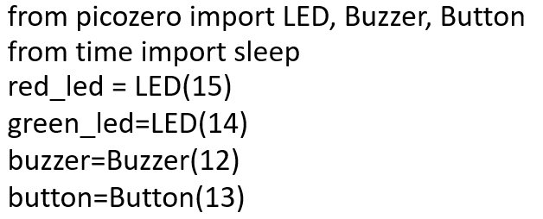

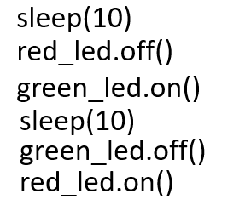
ex3d.py
from picozero import LED, Buzzer, Button
from time import sleep
red_led = LED(15)
green_led=LED(14)
buzzer=Buzzer(12)
button=Button(13)
red_led.on()
green_led.off()
How to convert this into a functon
def greenman():
Run program
Save it as ex3e.py
while True:
sleep(10)
red_led.off()
Give a name for your function. Let’s call it
greenman()
green_led.on()
sleep(10)
green_led.off()
red_led.on()
while True:
greenman()

Slide 24

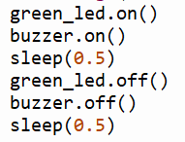
ex3e.py
BEFORE THE GREEN LIGHT GOES OFF, WE WANT TO
ALERT THE PEDESTRIAN BY FLASHING THE GREEN LED AND BUZZER
How?
WHERE in the
program
to add this function?
def greenman():
10 X
while True:
greenman()

Slide 25
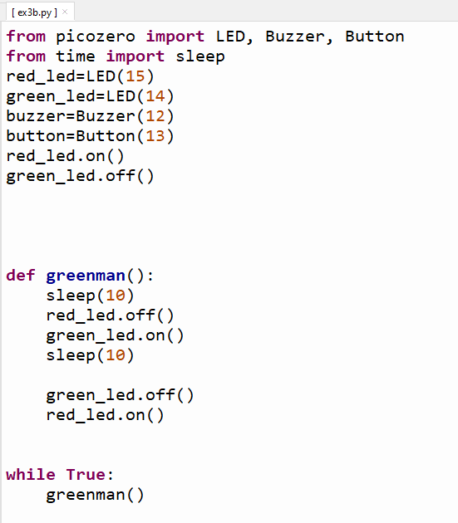
ex3e.py
Run program
Save it as ex3f.py

Slide 26
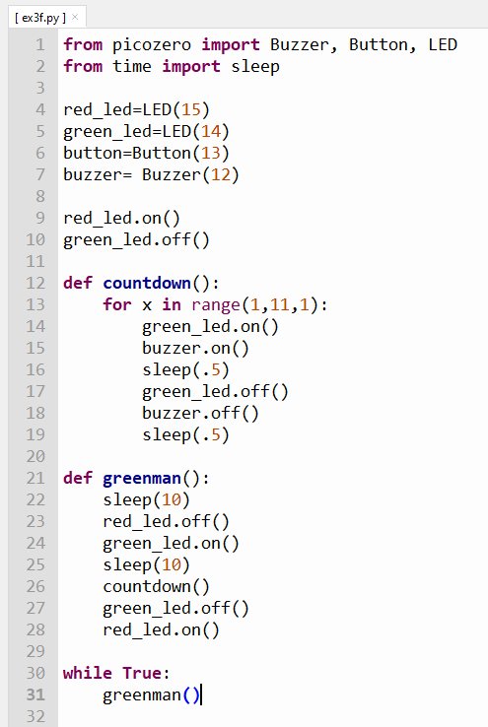


ex3f.py
This program works fine.
But in the real world, it’s not practical.
Why?
If no one wants to cross, the program will still continue to work
We want this program to run only
when someone presses the button. How can we make use of the button
Make this change
Run program
Save it as ex3g.py

Slide 27


HOME WORK (OPTIONAL)
Install ChatGPT app on your phone
Bring a thumb drive if you want to save your work
Install Thonny on own laptop/computer:
Search for Thonny in browser
Follow the lesson on this video
https://youtu.be/A2NnIWCYnMQ?si=gOc3Jojl_TgXHxmE
Run the installation. Thonny will be installed together with Python

Slide 28
Python Lesson – Session # 3
LIBRARY
tm1637
FUNCTIONS
FLOW CONTROL
  CONDITIONAL STATEMENTS
  if else
  LOOPS
  for loop

Slide 29
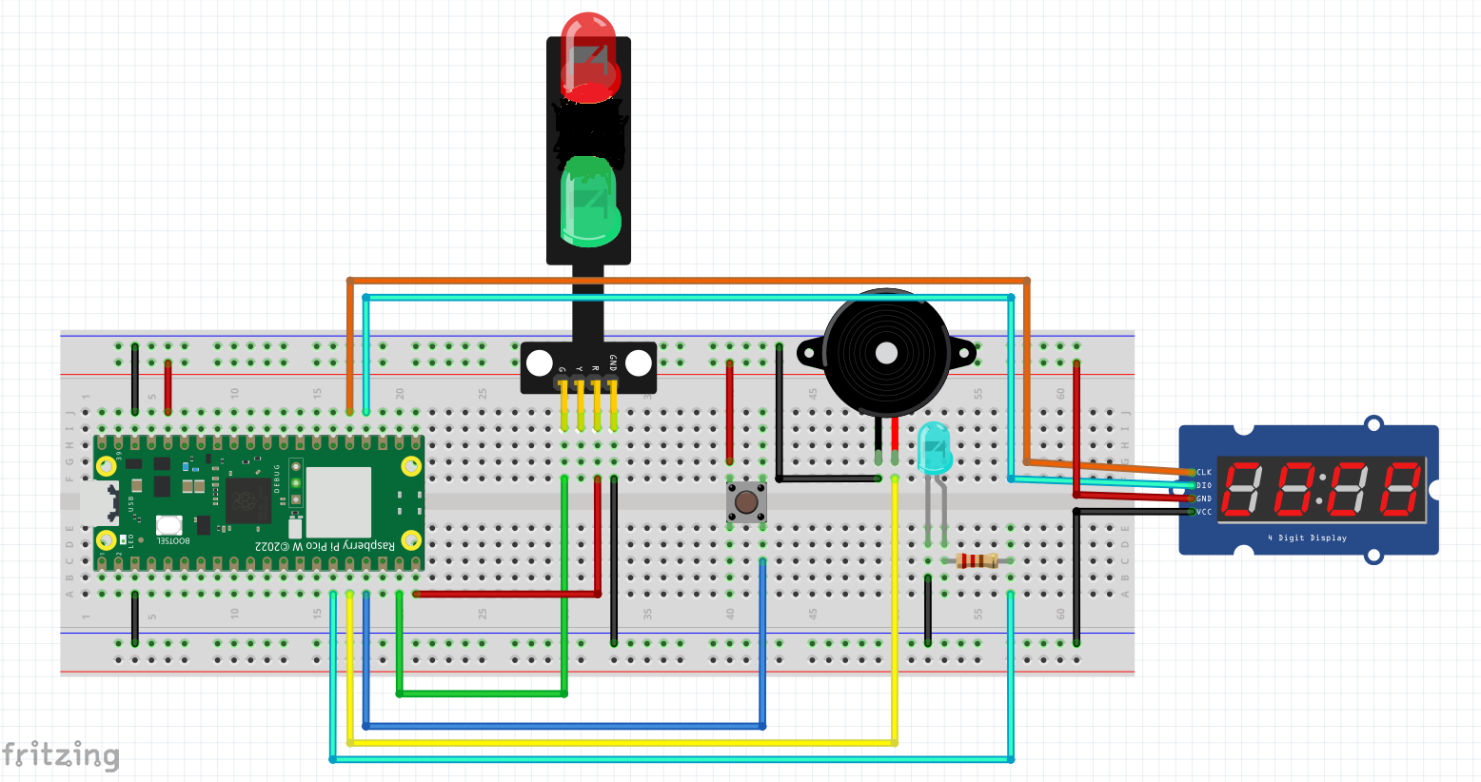

Exercise 4 – Full Fledge Pedestrian Crossing
CLK – Pin 19
DIO – Pin 18
Markings on reverse side
+
PIN 15
PIN 14
PIN 13
PIN 12
PIN 11
We need another Library
to work with this device,
called a 7 Segment Display
Library: tm1637.py

Slide 30
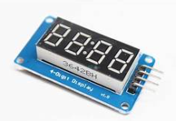
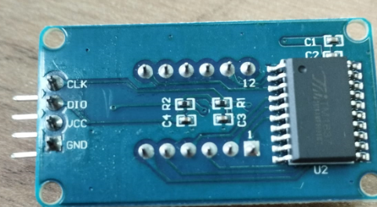
EXERCISE 4a – THE 7 SEGMENT DISPLAY
>>> from machine import Pin
>>> import tm1637
>>> tm = tm1637.TM1637(clk=Pin(19), dio=Pin(18))
>>> tm.show(“help”)
In python " " * 4 means 4 SPACES
This will clear the display.
Make sure there is a SPACE in between the quotation marks
>>> tm.number(1234)
>>> tm.temperature(24)
>>> tm.show(" " * 4)
Exercise 4a. Display the following
PICO
95
70 Degrees Celcius
Clear the display

Slide 31
COUNT DOWN DISPLAY
from machine import Pin
from time import sleep
import tm1637
tm = tm1637.TM1637(clk=Pin(19), dio=Pin(18))
for x in range(10,-1,-1):
tm.number(x)
sleep(1)
Run program
Save as ex4b.py
Try Counting from 0 to 10.
Refer to ex3f.py if you are not sure how to count upwards

Slide 32
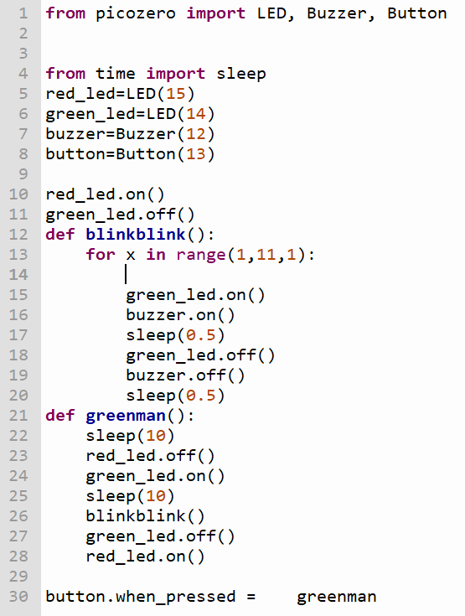
Modify ex3g.py to add
Count down to
countdown()
Besides the green man
flashing and the buzzer
beeping
the counter will show
how much time left
for crossing
countdown()
tm.show(“ “ * 4)
Run this amended program
Save as ex4c.py

Slide 33
Anti Spamming
PEDESTRAIN CROSSING BUTTON PRESSED
ANTI SPAM ON?
YES
PASS
NO
TURN ANTI SPAM LED ON
RUN greenman()

Slide 34
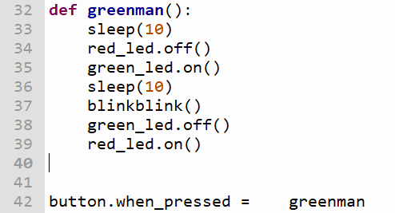
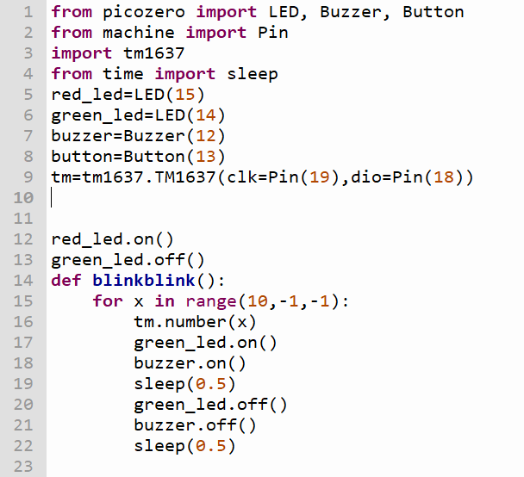

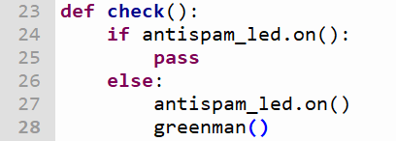
MODIFY ex4c.py to add antispam control
4)
PEDESTRAIN CROSSING BUTTON PRESSED
ANTI SPAM ON?
YES
PASS
NO
TURN ANTI SPAM LED ON
RUN greenman()
Run Program
Save as ex4d.py

Slide 35
def greenman():
sleep(10)
red_led.off()
green_led.on()
sleep(10)
countdown()
green_led.off()
red_led.on()
antispam_led.off()
tm.show(" " * 4)
button.when_pressed= check
from picozero import LED, Buzzer, Button
from machine import Pin
import tm1637
from time import sleep
red_led=LED(15)
green_led=LED(14)
buzzer=Buzzer(12)
button=Button(13)
tm=tm1637.TM1637(clk=Pin(19),dio=Pin(18))
antispam_led=LED(11)
antispam_led.off()
red_led.on()
green_led.off()
tm.show(" " * 4)
def countdown():
for x in range(10,-1,-1):
tm.number(x)
green_led.on()
buzzer.on()
sleep(0.5)
green_led.off()
buzzer.off()
sleep(0.5)
def check():
if antispam_led.value == 1:
pass
else:
antispam_led.on()
greenman()

Slide 36

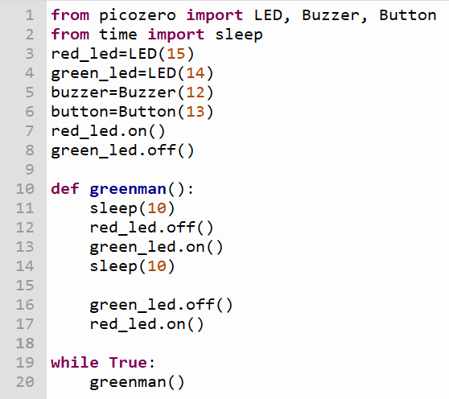
Patrol Car Ex – Putting knowledge gained to use
Use your blue , red LED and a Buzzer to make a noisy flashing lights on a patrol car
Choose any pin you wish
Wire up the circuit and write the python code to make it work
Use this example
HINT
Material
1 x Red LED
1 x Blue LED
1 x Buzzer
Python Code
picozero and time library
while True:
Red LED on and off
Blue LED on and off
Sleep in between on and off
Save your program
As patrolcar.py
And RUN

Slide 37
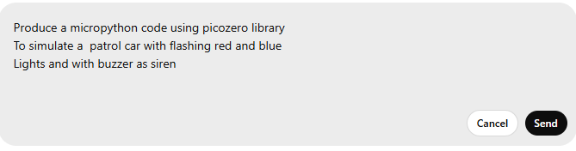
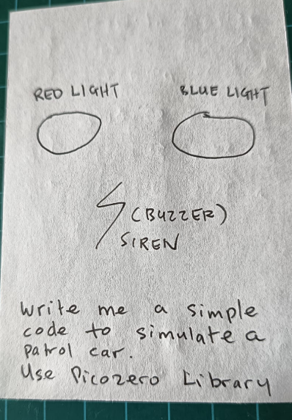
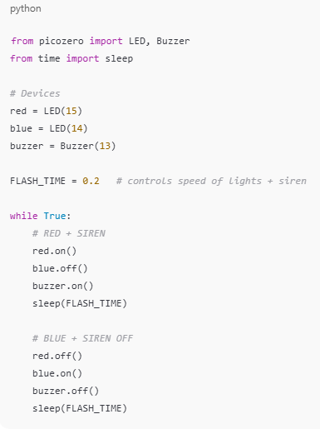
Python Lesson – Session # 4
INTRODUCTION TO CHATGPT
GENERATING A PYTHON PROGRAM USING CHATGPT
          Using Prompts
  Using a sketch

Slide 38
Python Lesson – Session # 4
Sample Training Videos / AI as a Tutor
  https://www.youtube.com/watch?v=Ro_MScTDfU4
  Learn Python Programming in Only 30 Minutes
  https://www.youtube.com/watch?v=ix9cRaBkVe0
  Full python course for free
  https://www.youtube.com/watch?v=sFLRrsIln4k
  How to Learn Python With AI
  https://www.youtube.com/watch?v=nMCOB8KElwo
User input in Python is easy + exercises
https://github.com/ssgoh/The-Pi-Club/blob/main/Pi%20Python%20Workshop/Recommended%20Video%20Resources.txt

